Slide 1
National Association of Letter Carriers, AFL-CIO

Slide 2
NALC Facts
The NALC represents all CITY LETTER CARRIERS
Today, NALC is more than 270,000 active and retired letter carriers in 2,500 branches across the country

Slide 3
NALC Facts
Negotiates and enforces our contract with the Postal Service
  Negotiation / Interest Arbitration
  Dispute Resolution Process (Grievance Procedure)

Slide 4
NALC Facts
NALC is an “open shop” union
Over 92% of ALL letter carriers choose to be members of the NALC​
  Over 90% of the letter carriers in Region 9 are members

Slide 5

NALC Structure
All the officers of the NALC are letter carriers who have been elected by the members of the NALC
National President
Brian L. Renfroe

Slide 6
NALC Structure
NALC Headquarters is located on Capitol Hill in Washington, D.C.
National Association of Letter Carriers
100 Indiana Ave., NW
Washington, DC 20001-2144
202-393-4695

Slide 7
NALC Structure
There are 10 nationally elected resident officers working at NALC Headquarters
Every 4 years, they are elected by members across the country
Every NALC member has an equal vote in NALC officer elections

Slide 8
NALC Structure
There are 15 NALC regions throughout the country
Each region has an elected National Business Agent or NBA
The NBAs are elected every 4 years by the members within their region

Slide 9

NALC Region 9
Cliff E. Davidson, NBA​​
1101 Northchase Parkway SE Suite 3​
Marietta, GA 30067​
678-942-5295​
Regional Administrative Assistants​
Anthony Ali, Central Florida Branch 1091 ​
Dexter Lester, Winston-Salem, NC Branch 461​
Regional Grievance Assistant
Eric Sloan, Atlanta Branch 73
Regional Workers’ Compensation Assistant
Misty Wenger, Branch 3126
Regional Office Assistant
Felicie Strong, Branch 1119

Slide 10
NALC Structure
Each branch has their own elected officers who are elected by all the members within that branch

Slide 11
NALC Structure
Locations where letter carriers work have shop stewards
Shop stewards are letter carriers that look out for your interests on the workroom floor

Slide 12
NALC Governance
Biennial National Convention

Slide 13
NALC Governance
Biennial National Convention
  Elected delegates from branches across the country attend a convention every two years
  Resolutions from branches are submitted, debated and voted on by the delegates
  Resolutions that pass become the official bargaining positions the NALC attempts to achieve in contract negotiations

Slide 14
NALC Governance
The NALC operates like a democracy
We are governed by our members from top to bottom

Slide 15
Questions???
Do you have any questions about the structure of the NALC?

Slide 16
NALC History
Founded in Milwaukee in 1889
Letter carriers did not have the right to negotiate a contract.
  Relied on Congress for pay raises
  Relied on Congress and the courts for our rights

Slide 17
NALC History
Congressional Action
  1888 – 8 hour work day established
  1916 – Federal Employees Compensation Act (FECA)
  1920 – Civil Service Retirement Act
  1970 – Postal Reorganization Act

Slide 18
NALC History
As late as 1970, wages were so low that many letter carriers were eligible and received welfare
In 1970, letter carriers had enough and went on strike
The strike was led by a letter carrier from New York City named Vince Sombrotto

Slide 19
NALC History
STRIKE!!

Slide 20
NALC History
Letter carriers earned full collective bargaining rights as a result of the strike
The old Post Office Department was transformed into the United States Postal Service

Slide 21
NALC History
Since 1971, there have been 15 National Agreements between the NALC and the Postal Service
    9 by negotiation and ratified by the membership
    6 by interest arbitration
Each contract achieved wage increases and improved working conditions

Slide 22
Questions???
Do you have any questions about the history of the NALC?

Slide 23
Evolution of the
Non-Career Workforce
Casuals
  1970-2006
  No benefits
  Limited to 2 consecutive 90-day terms
  No direct career path
  Could be separated at any time

Slide 24
Evolution of the
Non-Career Workforce
Transitional Employees (TEs)
  1992-1998 (DPS) 2007-2013 (FSS)
  360-day terms (minimum 5 day break)
  No direct career path
  Could be separated for lack of work during term or at end of term
  Management could choose which TE would be separated

Slide 25
Evolution of the
Non-Career Workforce
City Carrier Assistants (CCAs)
  Real, direct career path including conversion to PTF at 24 months of Relative Standing
  360-day terms (5 day break between appointments)
  Pay Step Increases / Holiday Pay
  Job security based on Relative Standing
  Affordable health insurance
  Uniform allowance
  Opting

Slide 26
CCA Rights and Benefits
Appointed to 360-day terms
5 calendar day break in service between terms
Break must be taken days 361-365 of your employment
Management may not, nor can the carrier agree to change their 5-day break.
PS Form 50 (Box 37) shows your break date

Slide 27
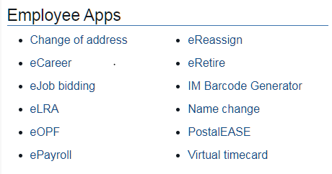


CCA Rights and Benefits

Slide 28
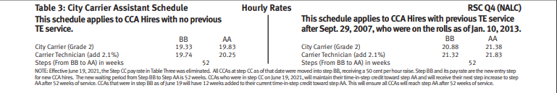
CCA Rights and Benefits
Pay rates City Carrier Assistants – Established in accordance with the City Carrier Assistant Schedule – Table 3 of the current pay scale

Slide 29
CCA Rights and Benefits
CCA holidays
The following six days shall be considered holidays for CCAs:
New Year’s Day, Memorial Day, Independence Day, Labor Day, Thanksgiving Day and Christmas Day
The amount of holiday pay a CCA will receive will be determined by the size of the office in which the CCA works.

Slide 30
CCA Rights and Benefits
Overtime Pay
  Time and one half for work over 8 hours in a service day and over 40 hours in a service week
Penalty Overtime Pay
  Double time for work over 10 hours in a day and over 56 hours in a service week

Slide 31
CCA Rights and Benefits
Night Shift Differential
  Additional hourly rate paid for time worked before 6:00 AM and after 6:00 PM
CCA Grade
BB, AA | $1.16
If a CCA is Temporarily assigned a Carrier Tech Position | $1.23

Slide 32
CCA Rights and Benefits
Relative Standing
  Similar to seniority
  Determined by the original CCA hire date in the installation
  Relative standing credit earned in one installation as a CCA does not transfer to another installation
  Currently CCAs may only convert to full-time career status in the installation where they work

Slide 33
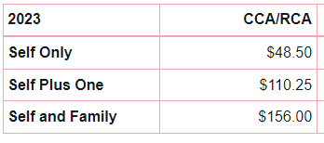
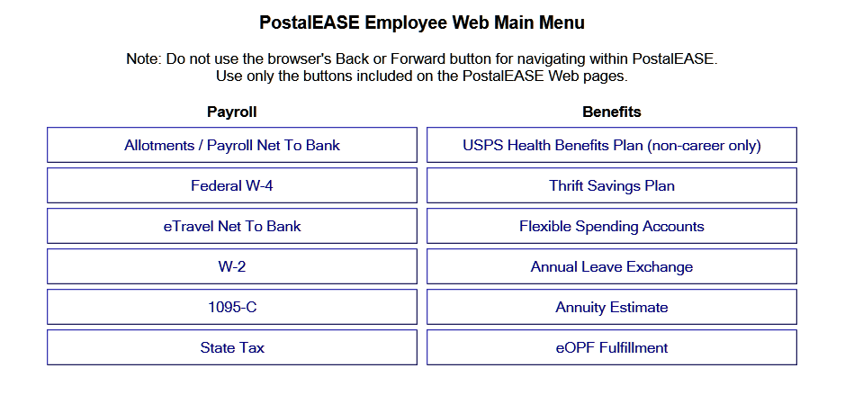
CCA Rights and Benefits
Health insurance
New employees have 60 days from their hire date to sign up for health insurance.

Slide 34
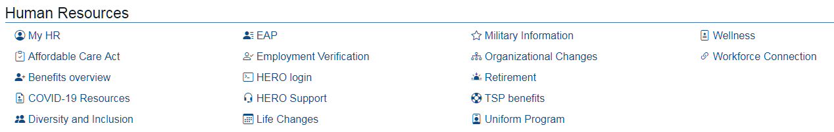

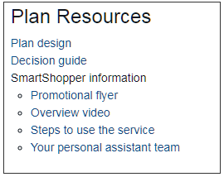

CCA Rights and Benefits
Or go to….. carefirst.com/usps

Slide 35
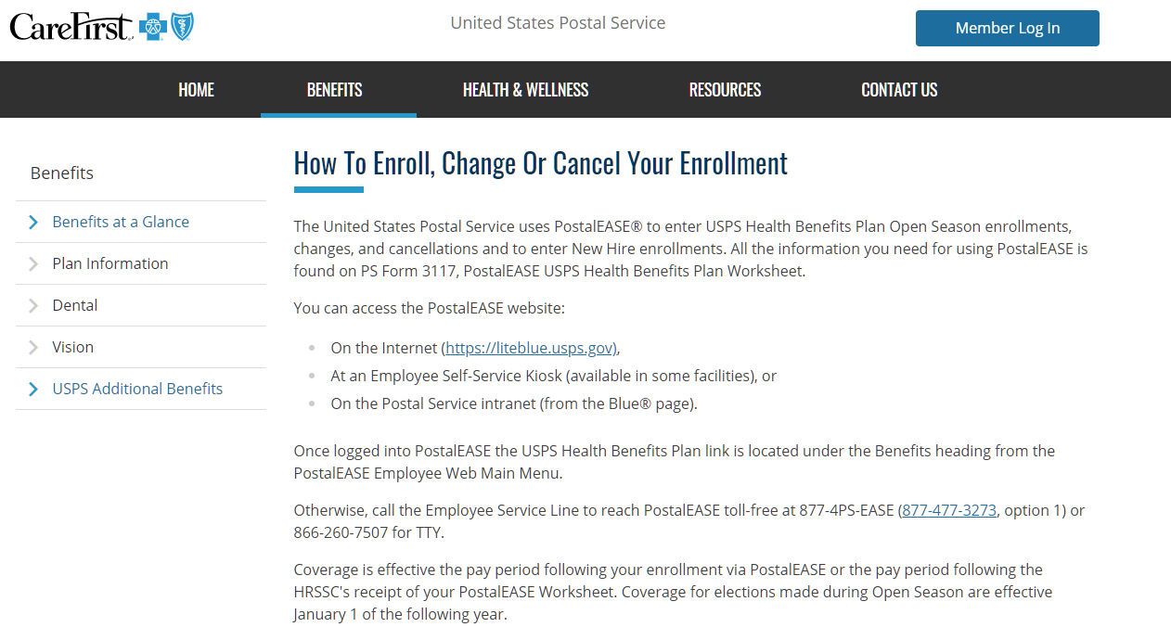
CCA Rights and Benefits

Slide 36
CCA Rights and Benefits
Uniforms
  Upon completion of 90 work days or 120 calendar days of employment as a CCA, whichever comes first, a CCA will be eligible for a uniform allowance
  Once established, the Uniform Allowance Anniversary will be the first date you become eligible to receive your allowance. The date will be the same throughout your career.

Slide 37
CCA Rights and Benefits
Uniforms
  CCAs receive an annual allowance from the USPS to purchase uniforms equal to that of career employees
05/21/21 $487.00
05/21/22 $499.00
A letter of authorization must be completed and provided to the employee within 14 days of eligibility.

Slide 38
CCA Rights and Benefits
Opting and Hold-downs
  A procedure, called “opting” allows carriers, including CCAs, to “hold down” vacant duty assignments of regular carriers who are on leave or otherwise unable to work for five or more days
  Ask other letter carriers, your OJI or your shop steward in your office how these temporary vacancies are advertised

Slide 39
CCA Rights and Benefits
Opting and Hold-downs
  Requests should be submitted to the supervisor in writing
  Keep a copy of the request
  Opting gives CCAs an opportunity to work a more consistent schedule and some choice over what work they perform
  CCAs become eligible to opt 60 calendar days from the date of appointment as a CCA

Slide 40
CCA Rights and Benefits
Work Schedules
  The service week for letter carriers begins on Saturday and ends on Friday
Work Hour Guarantees
  In larger Post Offices, CCAs are guaranteed four hours of work or pay anytime they are scheduled and report to work
  In Smaller post offices, CCAs are guaranteed two hours of work or pay anytime they are scheduled and report to work

Slide 41
CCA Rights and Benefits
Annual Leave
  CCAs earn 1 hour of annual leave (AL) for each unit of 20 hours in a pay status during each 2-week pay period. CCAs will receive a lump sum payment for any unused annual leave at the conclusion of their 360 day term.
Hours in a Pay Status | Hours of AL Earned Per Pay Period
20 | 1
40 | 2
60 | 3
80 | 4 (max)
Annual Leave submissions are done locally on a
PS Form 3971 and are subject to the installations Local Memorandum of Understanding (LMOU)

Slide 42
CCA Rights and Benefits
MOU – Re: Bereavement Leave
  Gives the employees the right to use up to three workdays of leave in the unfortunate event of the death of certain family members
  CCAs do not earn sick leave, so they may only use annual leave or leave without pay (LWOP) for bereavement purposes
  Additional leave can be used with management approval

Slide 43
CCA Rights and Benefits
MOU – Re: Bereavement Leave
  Son or Daughter – a biological or adopted child, stepchild, daughter or son-in-law
  Spouse
  Parent (including in-laws)
  Sibling – brother, sister, brother in-law, sister in-law
  Grandparent

Slide 44
CCA Rights and Benefits
Discipline Procedure
  CCAs have access to the grievance procedure if disciplined or removed
  If disciplined or removed, CCAs should let the shop steward or branch officers know as soon as possible
  Grievances must be filed within 14 days of the date you receive discipline, or it is a waiver of the grievance procedure

Slide 45
CCA Rights and Benefits
Weingarten Rights
  If called to a meeting with management, postal inspectors, or an OIG agent, read the following BEFORE the meeting starts:
  “If this discussion could in any way lead to my being disciplined or terminated, or affect my personal working conditions, I respectfully request that my union representative, officer, or steward be present at this meeting. Without my Union representation present, I respectfully choose not to answer any questions or participate in this discussion.”
  * The above recommendation is not legal advice. If you believe that you may be the subject of a criminal investigation, you should consult with an attorney.

Slide 46
Questions???
Do you have any questions regarding your rights and benefits as a City Carrier Assistant?

Slide 47
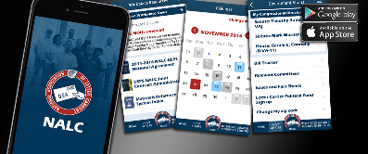
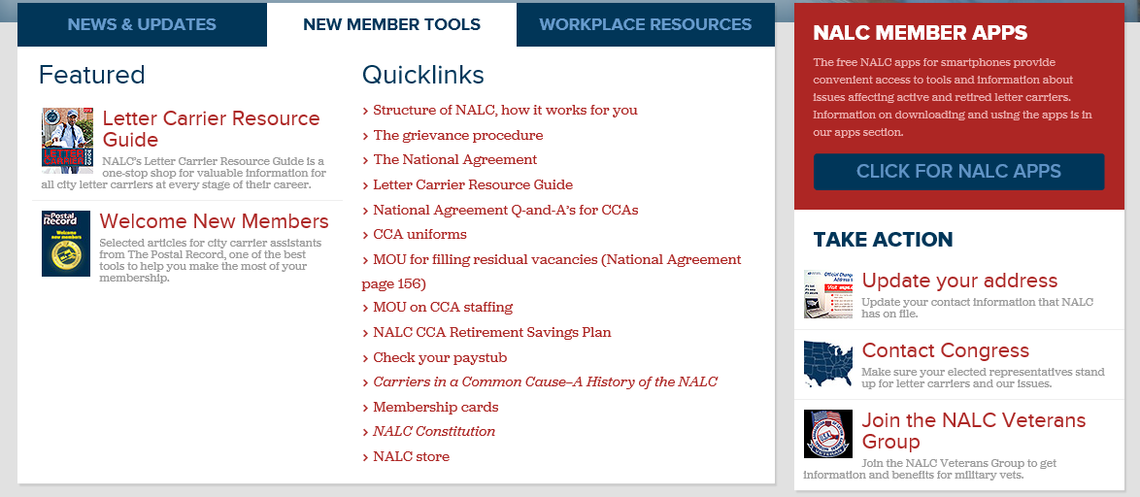
NALC Connects with Members
NALC website – www.nalc.org
NALC Member Smartphone app
Letter Carrier Resource Guide

Slide 48

2019
Letter Carrier Resource Guide
  Comprehensive Guide for ALL Letter Carriers
  Contract Rights and Benefits for both career and CCA letter carriers
  On-the-Job included workroom floor issues along with USPS procedures and forms and much more
  Available for online viewing or you can receive a hard copy by requesting at nalc.org

Slide 49
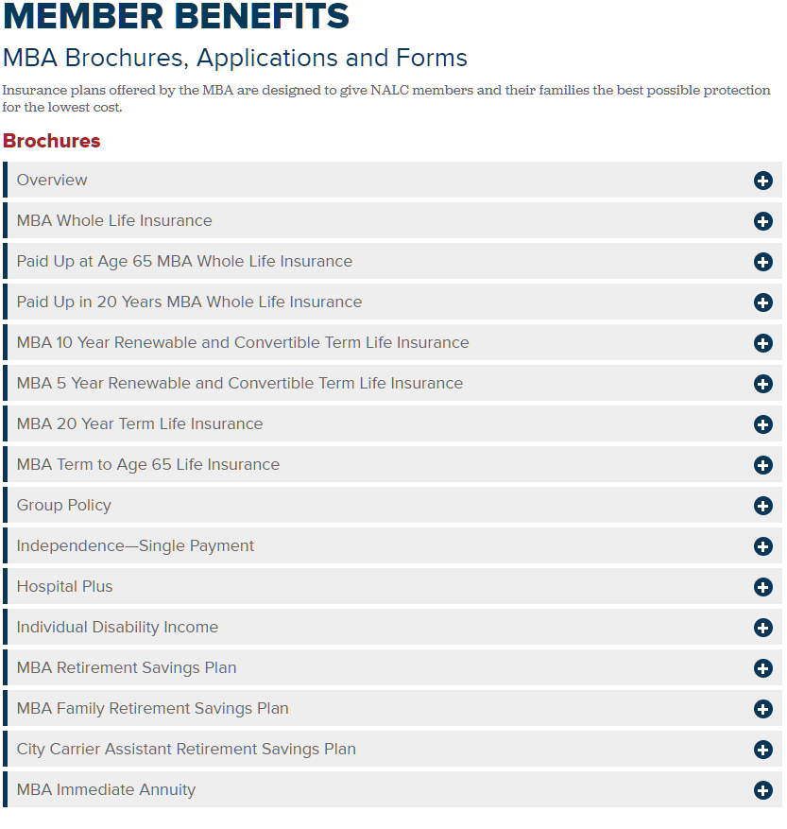
Mutual Benefit Association (MBA)
  Life Insurance and Annuities for
  NALC members and their families
  For more information or
  questions call (202) 638-4318

Slide 50
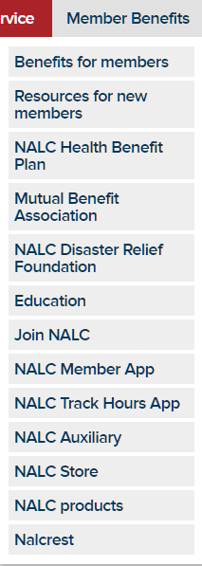
NALC Member Only Benefits
  $5,000 Accidental Death Benefit
  OWCP Assistance
  NALC Scholarships
  Postal Record
  MBA - CCA Retirement Savings Plan

Slide 51
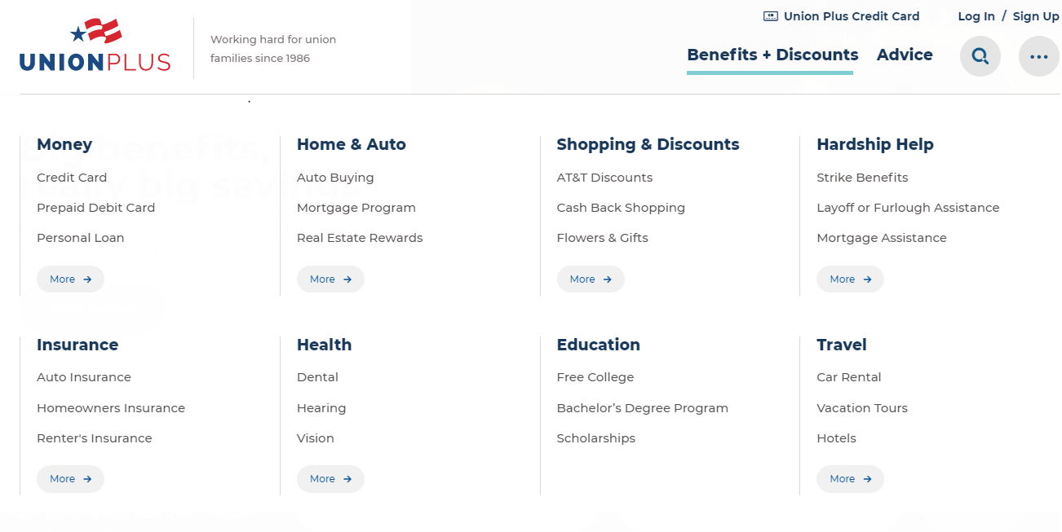
Union Plus Programs and Discounts
  For more information, go to… www.unionplus.org

Slide 52
Questions???
  Do you have any other questions about the NALC and your new job with the Postal Service?

